Slide 1
Earthquake Prediction
Big data analytics track Project – Submitted by Shalini gupta

Slide 2
Profile Details
Name: Shalini Gupta
Email ID: shalini2501@gmail.com
Course Enrolled: Big Data Analytics
Project Name: Earthquake Prediction

Slide 3
Project Details
Domain: Disaster Management and Recovery
Topic: Earthquake Prediction
Technologies used: Hadoop, Spark Core, Spark SQL, Scala, Spark MLLib

Slide 4
Project Introduction
Project is to design a Real-Time Earthquake Detection Model to send lifesaving alerts, which should improve its machine learning to provide near real-time computation results.
Dataset: earthQuackData.xls

Slide 5
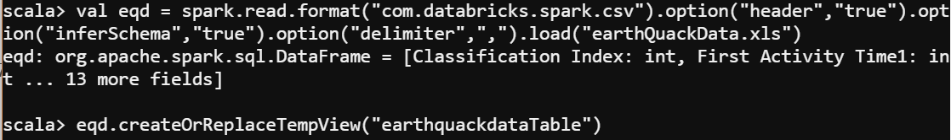
Code used to build the dataframe and Table in Spark
Code to create DATA Frame:
Code to create table:
val eqd = spark.read.format("com.databricks.spark.csv").option("header","true").option("inferSchema","true").option("delimiter",",").load("earthQuackData.xls")
eqd.createOrReplaceTempView("earthquackdataTable")

Slide 6
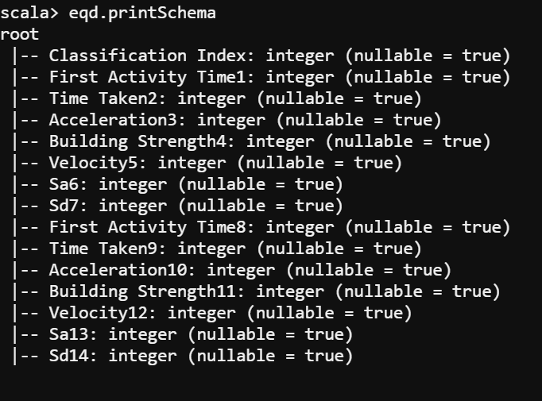
Dataset Description
Meta Data of earthQuackData:
Primary Wave
Secondary Wave

Slide 7
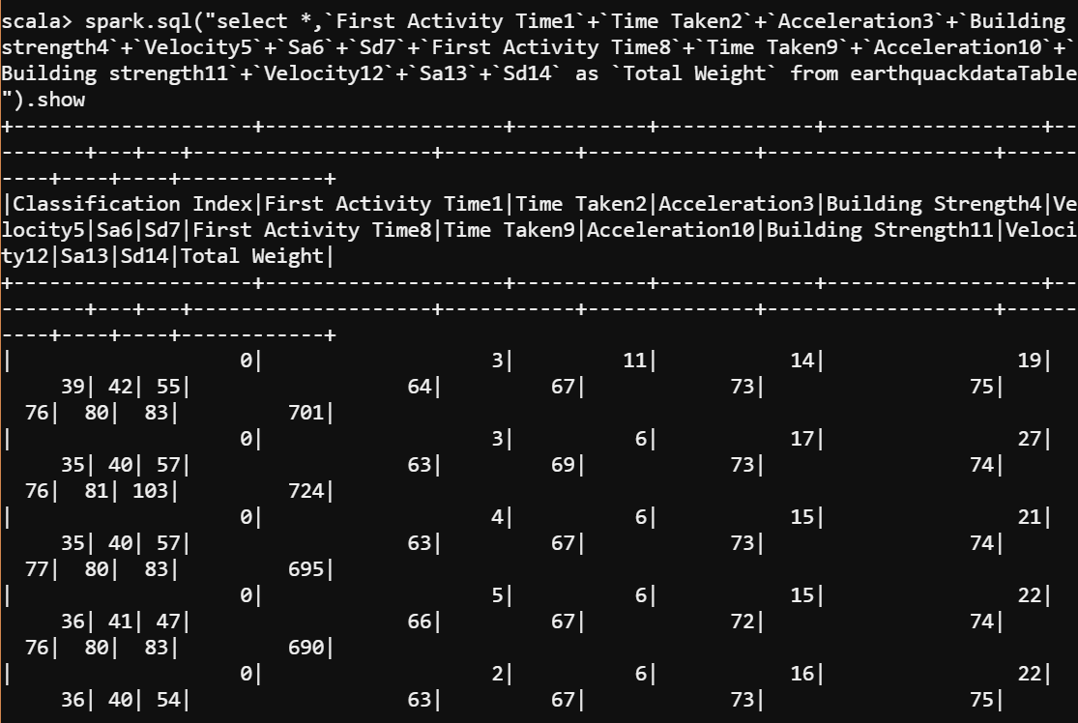
Question 1: Insert a column “Total Weight” which contains sum of respective cells in(II) to (XV)
Command used:
spark.sql("select *,`First Activity Time1`+`Time Taken2`+`Acceleration3`+`Building strength4`+`Velocity5`+`Sa6`+`Sd7`+`First Activity Time8`+`Time Taken9`+`Acceleration10`+`Building strength11`+`Velocity12`+`Sa13`+`Sd14` as `Total Weight` from earthquackdataTable").show

Slide 8
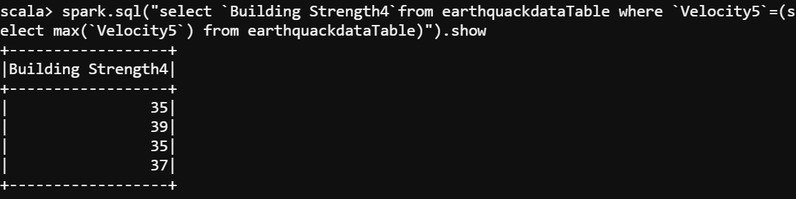
Question 2: Find the Building Strength(s) for the maximum velocity in the Primary Wave.
Command used:
spark.sql("select `Building Strength4`from earthquackdataTable where `Velocity5`=(select max(`Velocity5`) from earthquackdataTable)").show

Slide 9
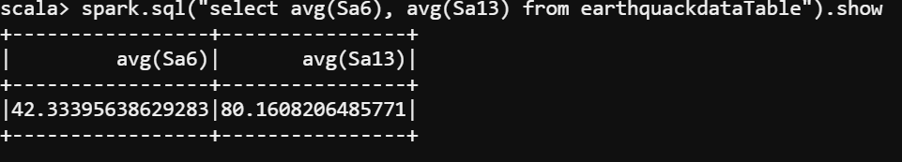
Question 3: Find the average value of Sa for both primary and secondary wave
Command used:
spark.sql("select avg(Sa6), avg(Sa13) from earthquackdataTable").show

Slide 10
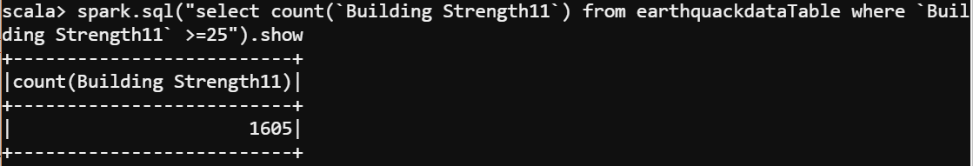
Question 4: Count the number of instances where Building strength remains equal to or greater than 25 after the secondary wave
Command used:
spark.sql("select count(`Building Strength11`) from earthquackdataTable where `Building Strength11` >=25").show

Slide 11
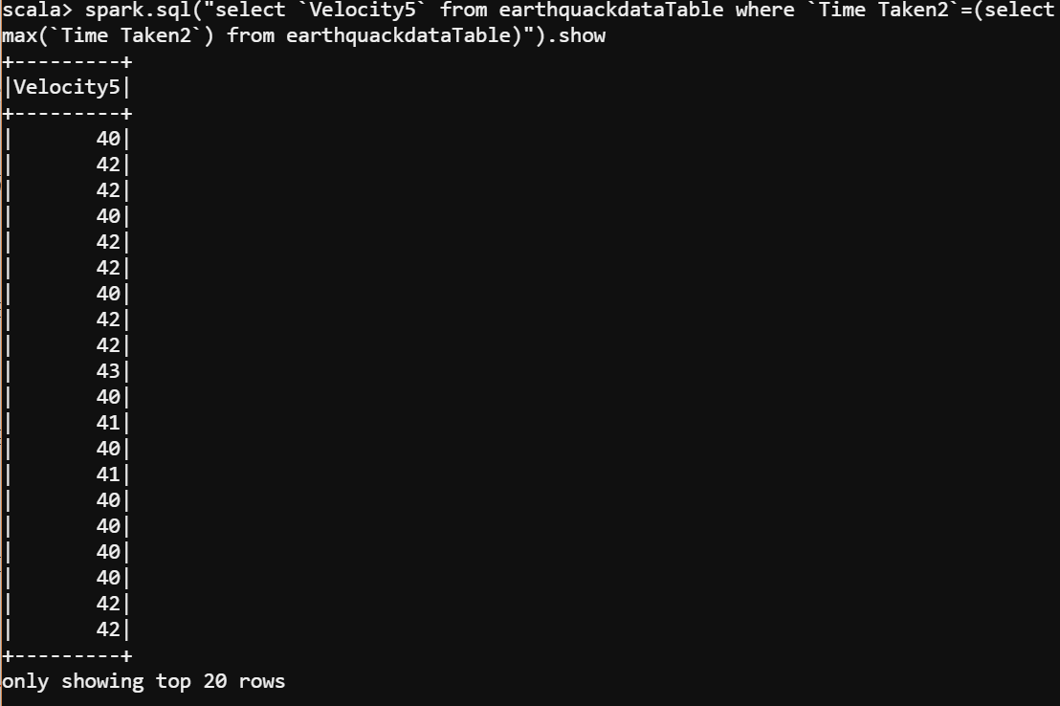
Question 5: Find the velocity for the primary wave which takes the maximum time
Command used:
spark.sql("select `Velocity5` from earthquackdataTable where `Time Taken2`=(select max(`Time Taken2`) from earthquackdataTable)").show

Slide 12
SPARK MLLIb -Train the data for machine learning -Create a model for the trained data and predict features by mapping the model -Use binary classification metrics on the map to get the area under ROC -Print the area under ROC
Importing Packages:
import org.apache.spark.mllib.regression.LabeledPoint
import org.apache.spark.mllib.linalg.Vectors
import org.apache.spark.{SparkConf, SparkContext}
import org.apache.spark.mllib.classification.LogisticRegressionWithLBFGS
import org.apache.spark.mllib.evaluation.BinaryClassificationMetrics
import org.apache.spark.mllib.regression.LabeledPoint
import org.apache.spark.mllib.util.MLUtils
import org.apache.spark._
import org.apache.spark.sql.functions._
import org.apache.spark.sql.types._
import org.apache.spark.sql._
import org.apache.spark.rdd.RDD
import org.apache.spark.sql.SQLContext
import org.apache.spark.ml.feature.StringIndexer
import org.apache.spark.ml.feature.VectorAssembler

Slide 13
Creating Schema:
Reading Datafile:
val schema = StructType(Array(
StructField("ClassificationIndex", DoubleType, true),
StructField("pFirstActivityTime", DoubleType, true),
StructField("pTimeTaken", DoubleType, true),
StructField("pAcceleration", DoubleType, true),
StructField("pBuildingStrength", DoubleType, true),
StructField("pVelocity", DoubleType, true),
StructField("pSa", DoubleType, true),
StructField("pSd", DoubleType, true),
StructField("sFirstActivityTime", DoubleType, true),
StructField("sTimeTaken", DoubleType, true),
StructField("sAcceleration", DoubleType, true),
StructField("sBuildingStrength", DoubleType, true),
StructField("sVelocity", DoubleType, true),
StructField("sSa", DoubleType, true),
StructField("sSd", DoubleType, true)
))
val eqddf = spark.read.format("com.databricks.spark.csv").option("header", "true").option("inferSchema", "false").schema(schema).option("delimiter", ",").load("earthQuackData.xls")

Slide 14
Removing the records with NULL data:
Creating Features column:
Creating Label column:
Converting LabelPoint:
val eqd = eqddf.filter($"sSa".isNotNull)
val eq1 = eqd.filter($"sSd".isNotNull)
val featureCols = Array("pAcceleration","pVelocity", "pSa", "pSd","sAcceleration","sVelocity", "sSa", "sSd")
//set the input and output column names**
val assembler = new VectorAssembler().setInputCols(featureCols).setOutputCol("features")
//return a dataframe with all of the feature columns in a vector column**
val df2 = assembler.transform(eq1)
// the transform method produced a new column: features.**
val labelIndexer = new StringIndexer().setInputCol("ClassificationIndex").setOutputCol("label")
val df3 = labelIndexer.fit(df2).transform(df2)
val labeled = df3.rdd.map(row => LabeledPoint(
row.getAs[Double]("label"), org.apache.spark.mllib.linalg.Vectors.fromML(row.getAs[org.apache.spark.ml.linalg.DenseVector]("features"))
))

Slide 15
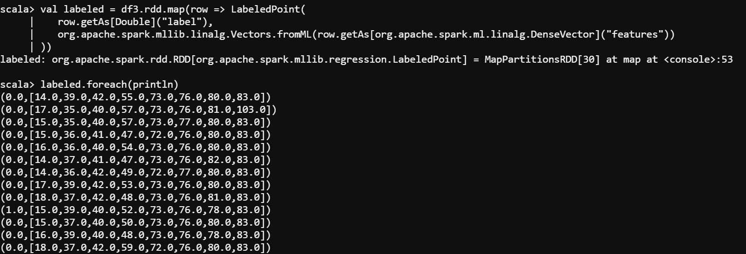

Slide 16
Training and Test data Split
Creating Model:
Clear the prediction threshold so the model will return probabilities:
Compute raw scores on the test set:
Instantiate metrics object:
Precision by threshold:
val Array(training, test) = labeled.randomSplit(Array(0.6, 0.4), seed = 11L)
training.cache()
val model = new LogisticRegressionWithLBFGS().setNumClasses(2).run(training)
model.clearThreshold
val predictionAndLabels = test.map { case LabeledPoint(label, features) =>
val prediction = model.predict(features)
(prediction, label)
}
val metrics = new BinaryClassificationMetrics(predictionAndLabels)
val precision = metrics.precisionByThreshold
precision.foreach { case (t, p) =>
println(s"Threshold: $t, Precision: $p")
}

Slide 17
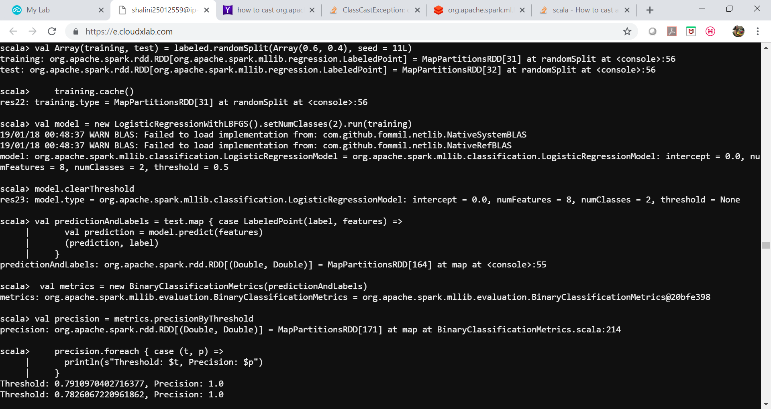

Slide 18
Recall by threshold:
Precision-Recall Curve:
F-measure:
val recall = metrics.recallByThreshold
recall.foreach { case (t, r) =>
println(s"Threshold: $t, Recall: $r")
}
val PRC = metrics.pr
val f1Score = metrics.fMeasureByThreshold
f1Score.foreach { case (t, f) =>
println(s"Threshold: $t, F-score: $f, Beta = 1")
}
val beta = 0.5
val fScore = metrics.fMeasureByThreshold(beta)
f1Score.foreach { case (t, f) =>
println(s"Threshold: $t, F-score: $f, Beta = 0.5")
}

Slide 19
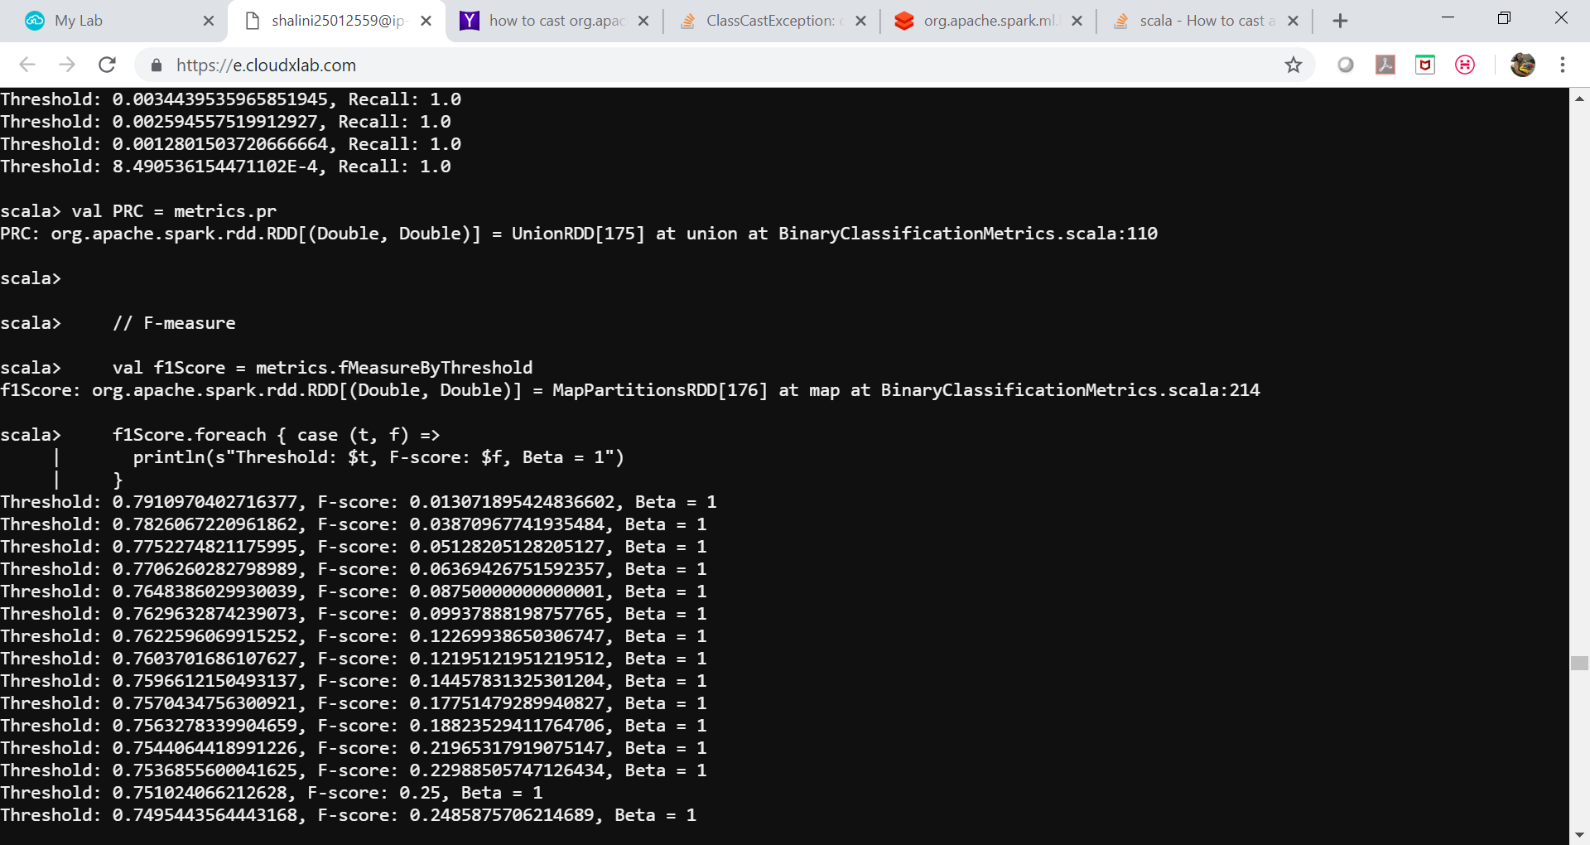

Slide 21
Priniting Area under ROC:
// AUPRC
val auPRC = metrics.areaUnderPR
println(s"Area under precision-recall curve = $auPRC")
// Compute thresholds used in ROC and PR curves
val thresholds = precision.map(_._1)
// ROC Curve
val roc = metrics.roc
// AUROC
val auROC = metrics.areaUnderROC
println(s"Area under ROC = $auROC")

Slide 22
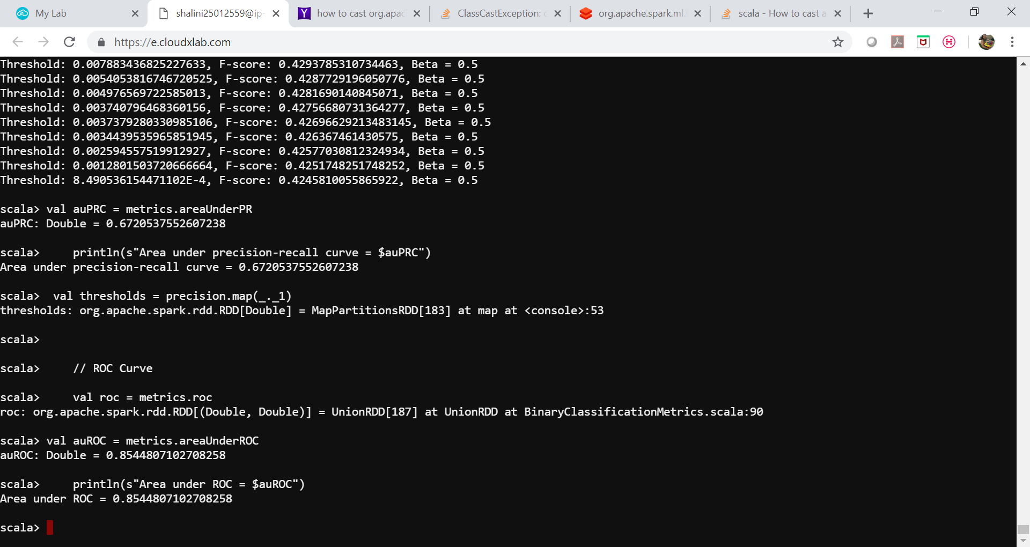

Slide 23
Thank you!!

